Slide 1
Automatic Field Boundary Detection
Automatic field boundary detection using AI

Slide 2
Main topics
1 | Crop field detection using graph-based image segmentation and contrastive learning
2 | Exploring techniques to collect training samples
3 | Exploring deep learning models suitable for this application
4 | Exploring segmentation methods

Slide 3
Crop field detection using graph-based image segmentation and contrastive learning
Team:
Eduardo Nascimento
Company Advisor: John Just (Ag & AI expert)
University Advisors: Tiago Almeida (NLP expert), Jurandy Almeida (Image/DL expert)

Slide 4
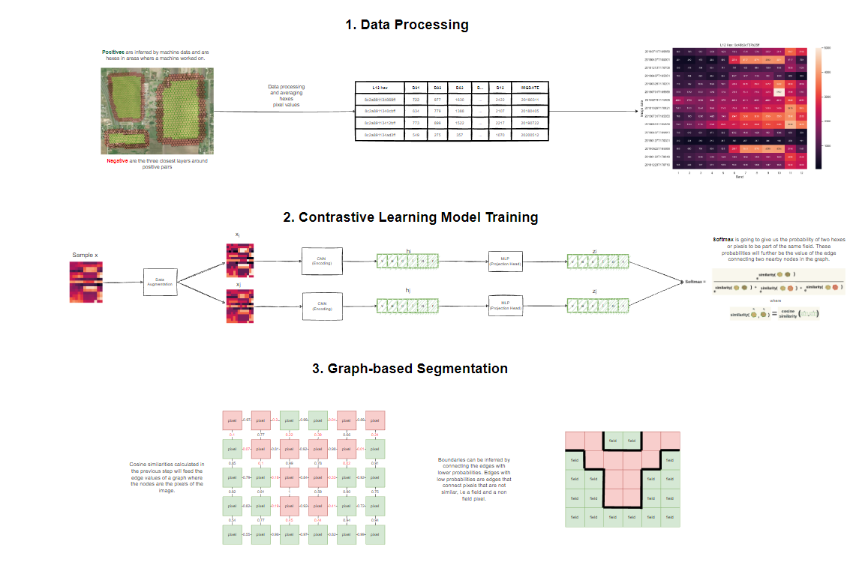
Crop field detection using graph-based image segmentation and contrastive learning

Slide 5
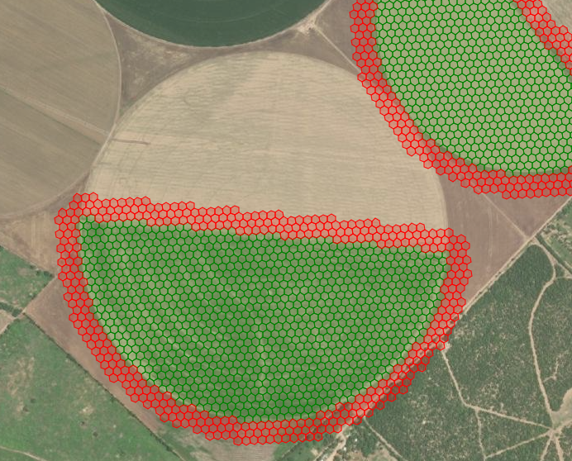
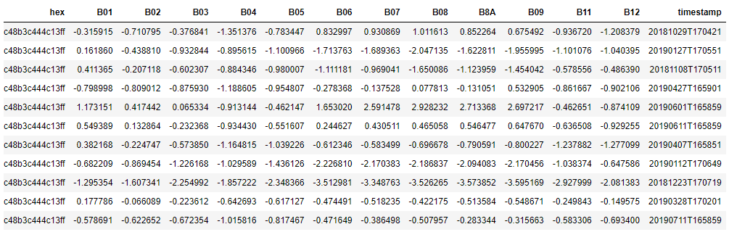
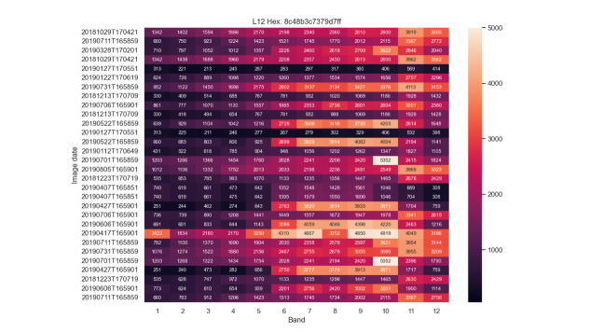
Crop field detection using graph-based image segmentation and contrastive learning

Slide 6
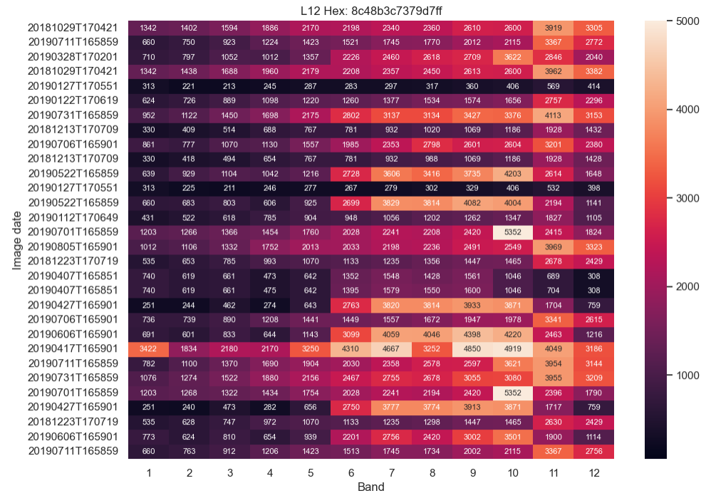
TIME SERIES SAMPLE

Slide 7
Crop field detection using graph-based image segmentation and contrastive learning
H3 LEVEL3
Multiple images Sentinel 2
12 bands
Parquet Files
TensorFlow tf.data API to manipulate large datasets.
Selection of number of images per sample.
Randomized time series sequence in the samples.
Selection of number of hexes per field.
H3 L3 LEVEL
FIELD LEVEL
FIELD GUID
…
FIELD GUID
H3 L12 LEVEL
…
…

Slide 8
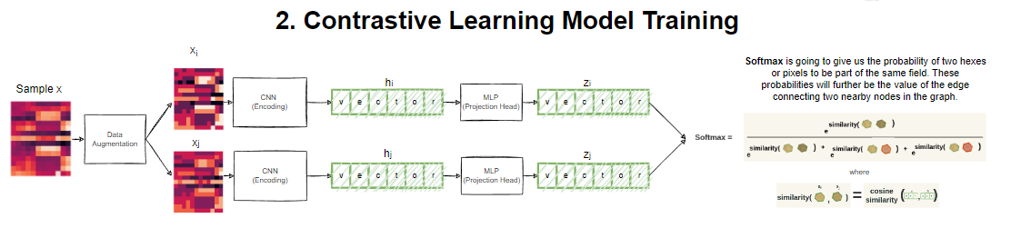
Crop field detection using graph-based image segmentation and contrastive learning

Slide 9
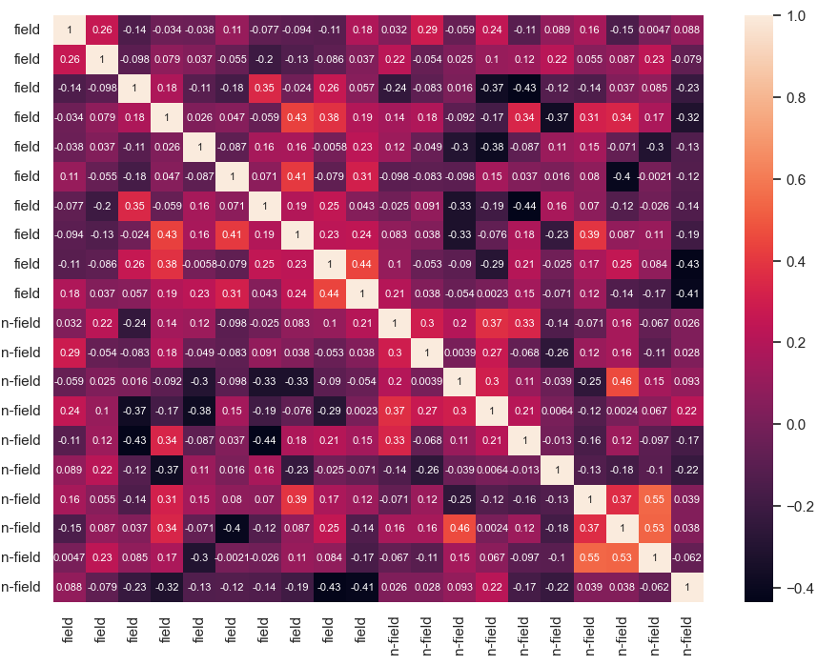
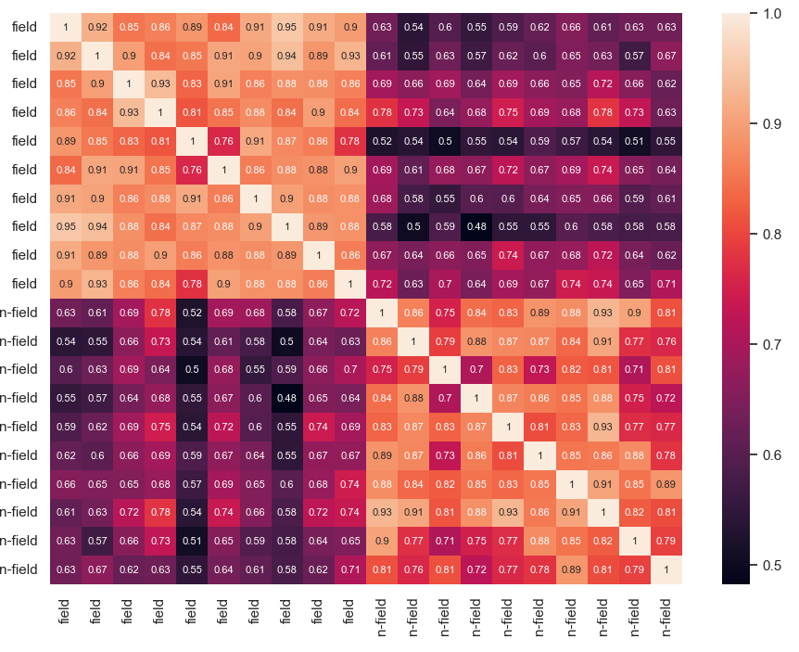
Crop field detection using graph-based image segmentation and contrastive learning
ENCODER
Cosine Similarity Matrix of 10 positive and negative samples
Increase the similarity between samples from the same class while repealing samples from different classes

Slide 10
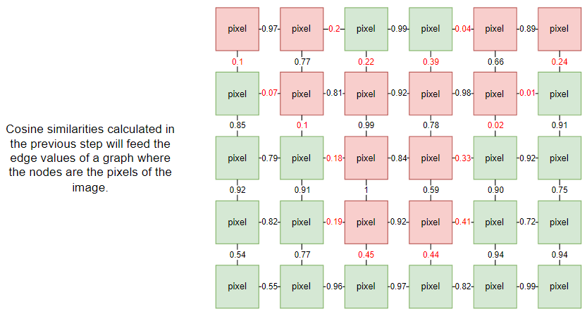
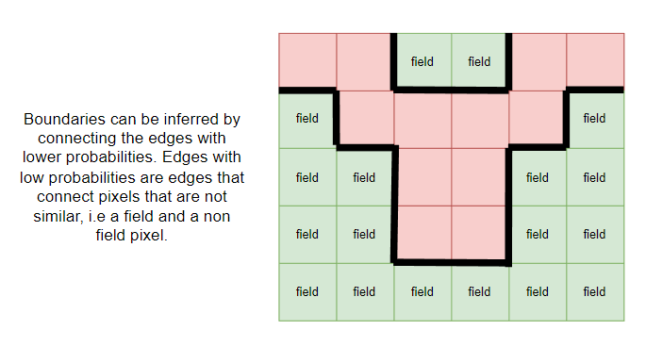
Crop field detection using graph-based image segmentation and contrastive learning

Slide 11
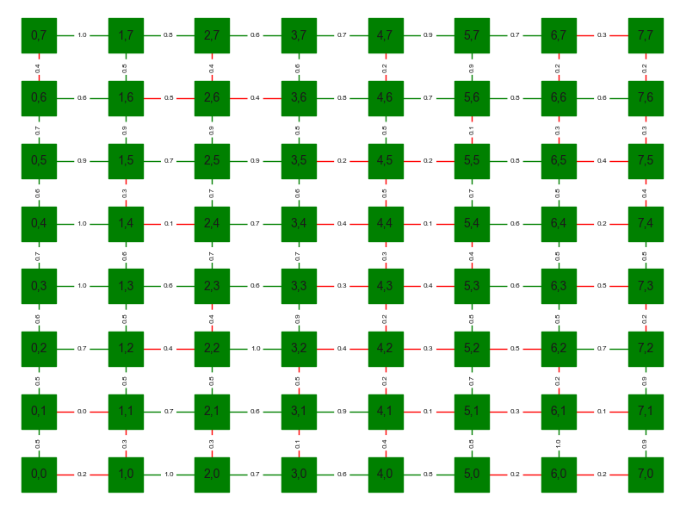
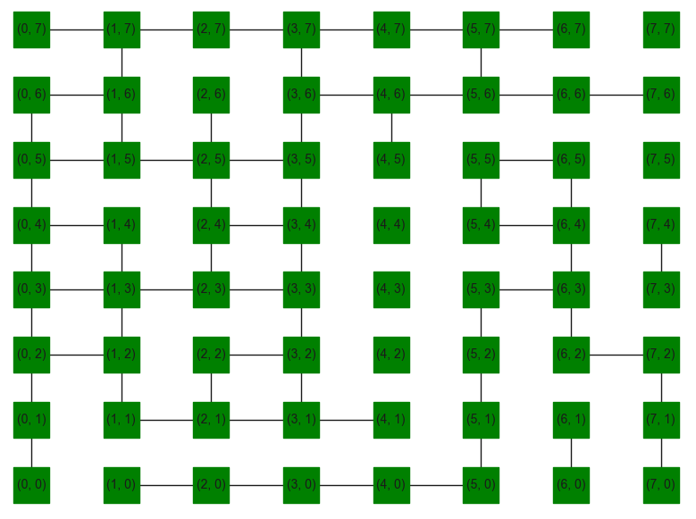
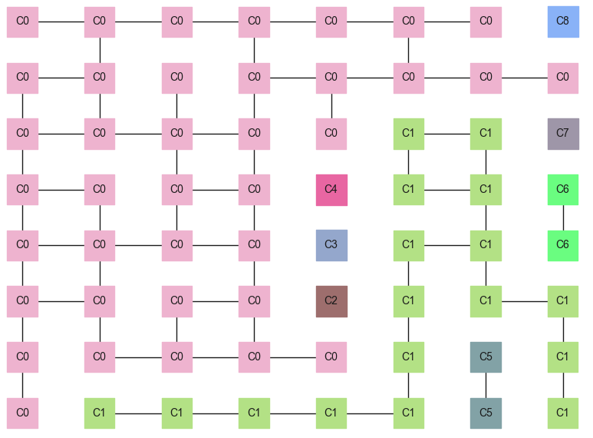
Crop field detection using graph-based image segmentation and contrastive learning
Connected Components

Slide 12
Crop field detection using graph-based image segmentation and contrastive learning
Connected Components

Slide 13
Crop field detection using graph-based image segmentation and contrastive learning
Different methods evaluation
SimCLR
NNCLR
Siamese Triplet Loss
OneClass / Few-shot Classification

Slide 14
Exploring different alternatives
Brainstorm of different approaches that can be used to automatically detect field boundaries

Slide 15
Dataset
Different options to be used to create a dataset with training samples

Slide 16
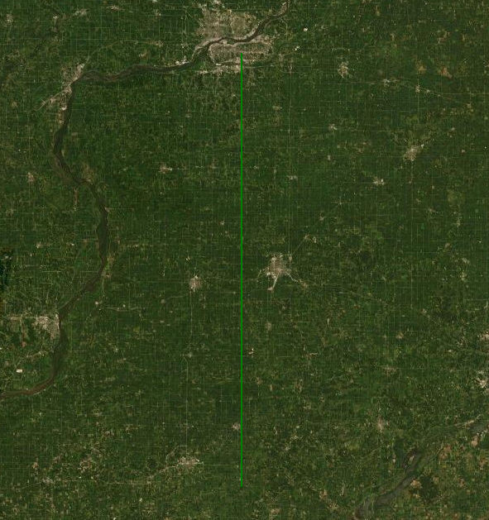
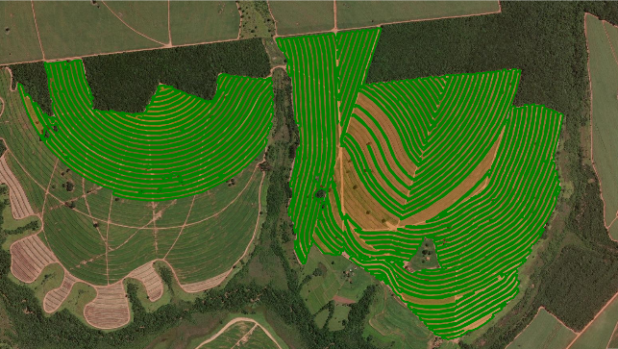
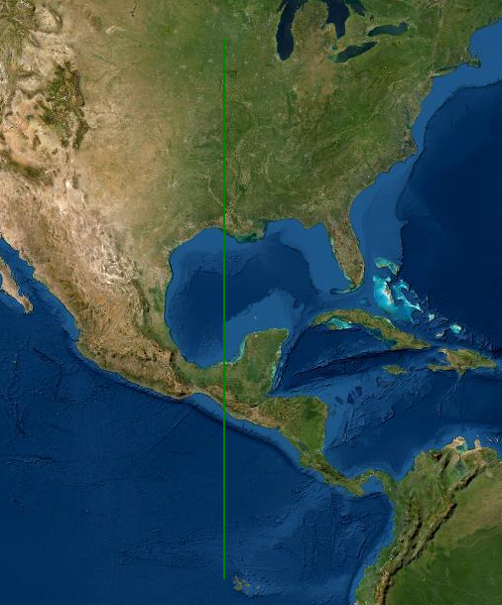
Field Boundaries created by customers as labels
Evaluation of the quality of boundaries created by customers
1. Size anomalies
2. Complexity anomalies
There are different approaches to filter inaccurate field boundaries that could be leveraged to use these boundaries for training.

Slide 17

High-Resolution Imagery
Options of high-resolution imagery (5x5) pixels representation
Rapid Eye (5m)
PlanetScope (4.8m)
Sentinel 2 (10m)
SPOT-6/7 (1.5m)
SkySat (50cm)
UAV Images (5 cm)
Worldview-3 (30cm)

Slide 18
Models
Different options of machine/deep learning models suitable for this application

Slide 19
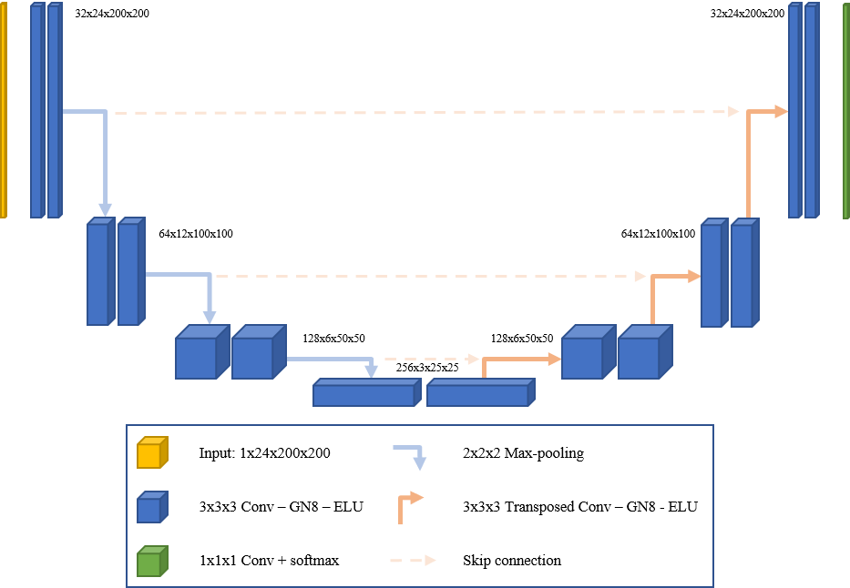
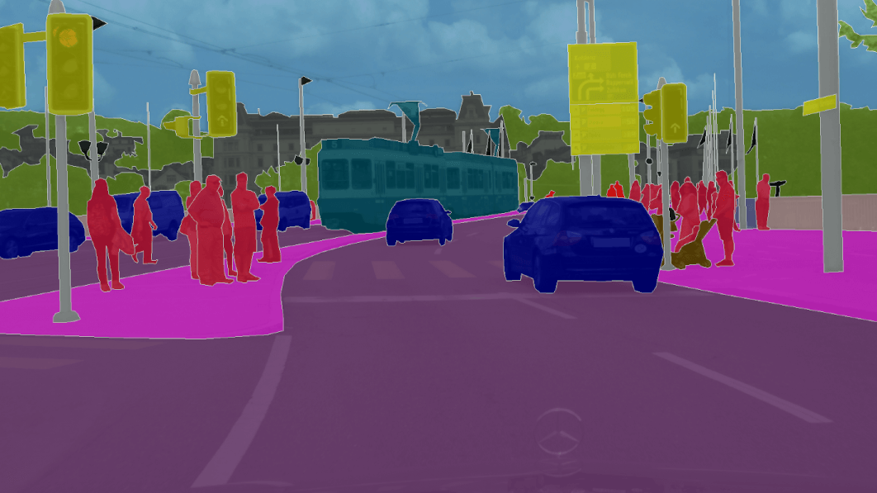
U-NET (Semantic Segmentation)
Deep learning segmentation originally proposed for medical imaging

Slide 20
U-NET improvements
ResUNet (2015)
ResUNet-a (2018)
ResUNet with attention mechanisms
Fractal ResUNet (2020)
ResUNet with fractal structure incorporated
UNet with residual connections

Slide 21
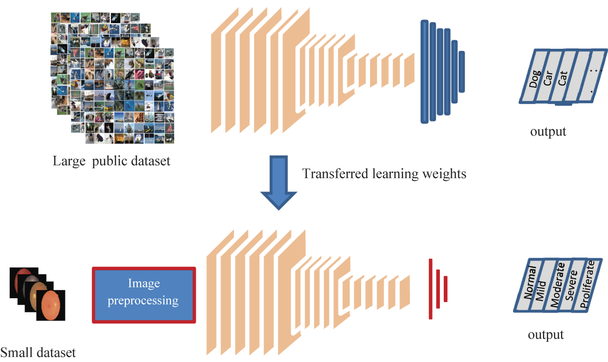
Transfer Learning
We could reuse training from areas with lots of John Deere machines to train areas with a limited number of John Deere customers.

Slide 22
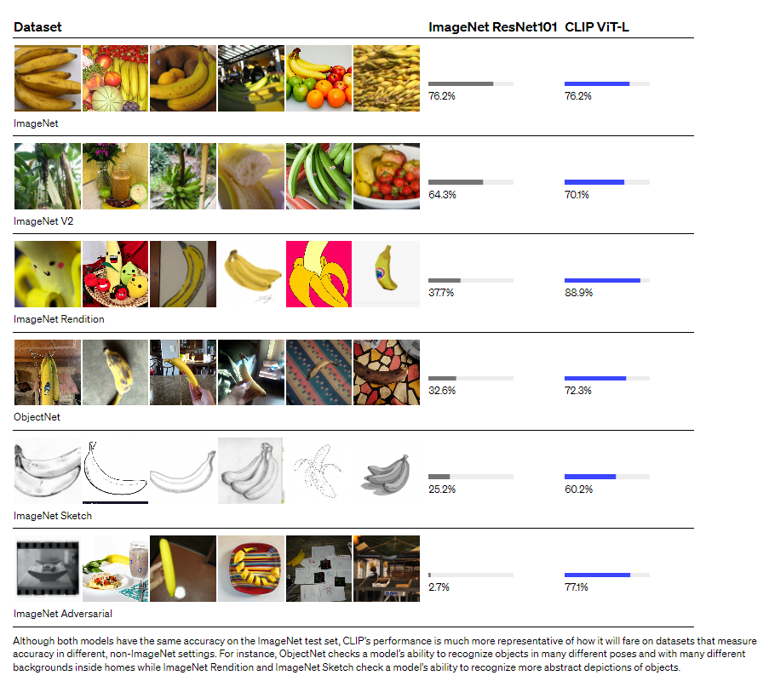
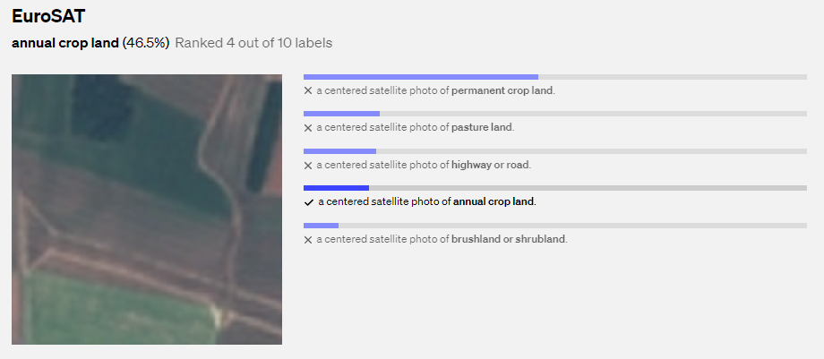
CLIP
OpenAI : Contrastive Language–Image Pre-training
https://openai.com/blog/clip/

Slide 23
Segmentation
Different techniques to convert the output of the model into shapes of detected fields / boundaries

Slide 24
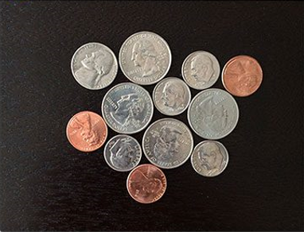
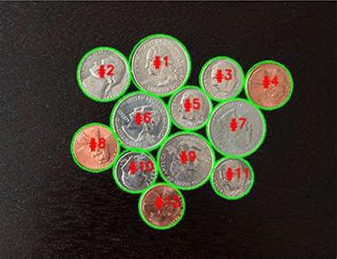
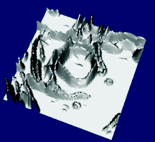
Watershed Segmentation
Segmentation technique that treats an image as a topographic surface

Slide 25
Bibliography & Resources
Bibliography documented in different ways to facilitate future research

Slide 26
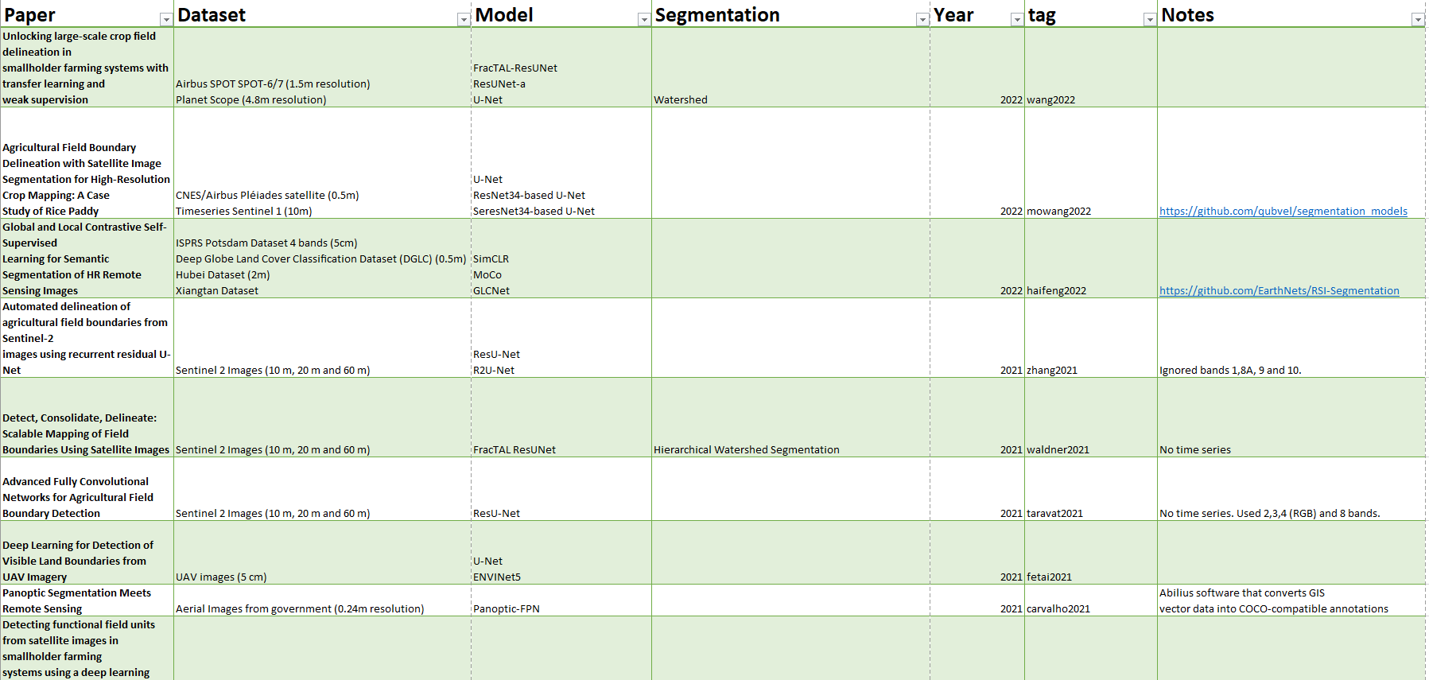
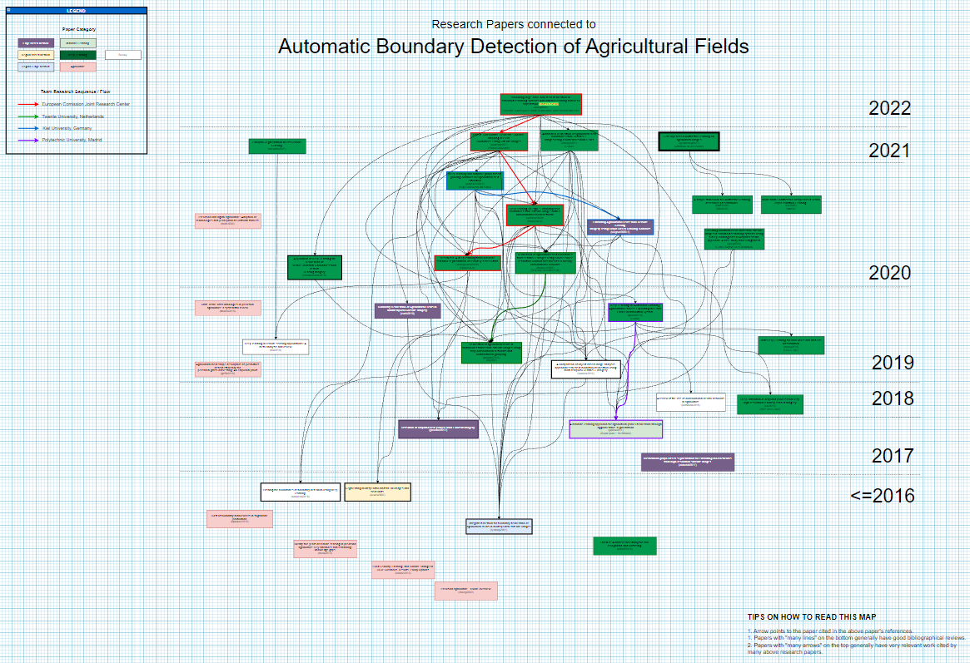
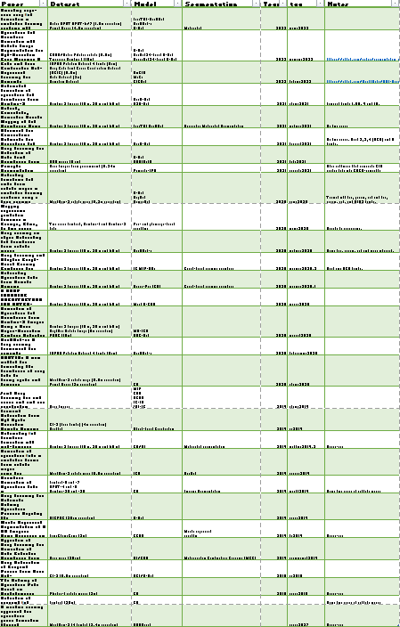
Bibliography documentation
Table with 30 related papers listing the dataset, model and segmentation technique applied.
Taxonomy of the related papers in a vertical timeline colored by approach and research group

